Slide 1
Task 01: Builidng a baseline model for D (2) Receptor Antagonists
Group 02: Abdelsalam Helala, Abdulrahman Walid, Ahmed, Fouzia Nasreen, Maham Ayesha, Saleha Attar

Slide 2
The Problem:
________________________________________________________________
Why are we doing this ? Understanding the CEO’s mandate.

Slide 3
The CEO’s mandate
High Cost of R&D: Drug discovery is slow and expensive. Manually testing thousands of molecules from a vendor catalogue is highly inefficient.
The Goal: Embrace Machine Learning (ML) to reduce costs and accelerate discovery by identifying the most promising candidates before synthesis or purchase.
The Task: Build a predictive model based on our existing data of ~12,000 molecules to screen new compounds virtually.

Slide 4
The Scientific Target:
_____________________________________________________________________
What biological system are we aiming for ?

Slide 5
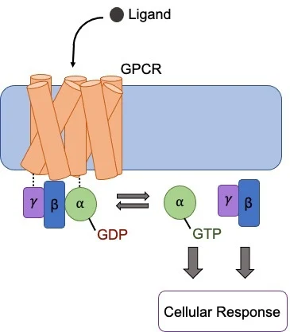
What are GPCRs?
G Protein-Coupled Receptors (GPCRs) are proteins on the surface of our cells. They act like an "inbox" for signals from outside the cell, such as hormones and neurotransmitters.
When a signal arrives, they "ring a bell" inside the cell, starting a biological response.
They are involved in sight, smell, mood, and immune response. Over 30% of all FDA approved drugs work by targeting GPCRs.

Slide 6
Our Target: The D(2) Dopamine Receptor
A key Brain Target
The D(2) receptor is a GPCR that responds to dopamine. It's crucial for the central nervous system (CNS), controlling mood, motivation, and motor function.
Agonists: The Key
An agonist (like dopamine) is a molecule that activates the receptor. It's the "key" that turns the lock and starts the signal.
Antagonists: The Blocker
Our goal is to find antagonists. These molecules block the receptor. They fit in the lock but don't turn it, preventing dopamine from getting in. This is the mechanism for most antipsychotic drugs.

Slide 7
Our Step-by-Step Workflow
_____________________________________________________________________
A 6 student approach to build the best model

Slide 8
Workflow: Data Preparation (Student 1)
______________________________________________________
Create Target (pKi)
Convert Ki (a skewed value) to pKi (a log scale) for better model training.
Load Data
Start with the ~12k molecule dataset (SMILES, Activity Type, Activity Value).
Clean & Filter
Filter for one activity type (Ki), remove salts/solvents, and standardize all SMILES.
Split Data
Split into 80% Training and 20% Testing sets, using random_state=42 for a fair comparison.

Slide 9
Four Experiments (students 2-5)
Experiment 1: RDKit Descriptors + XGBoost
Experiment 2: RDKit Descriptors + MLP
Experiment 3: Morgan Fingerprints + XGBoost
Experiment 4: Morgan Fingerprints + MLP

Slide 10
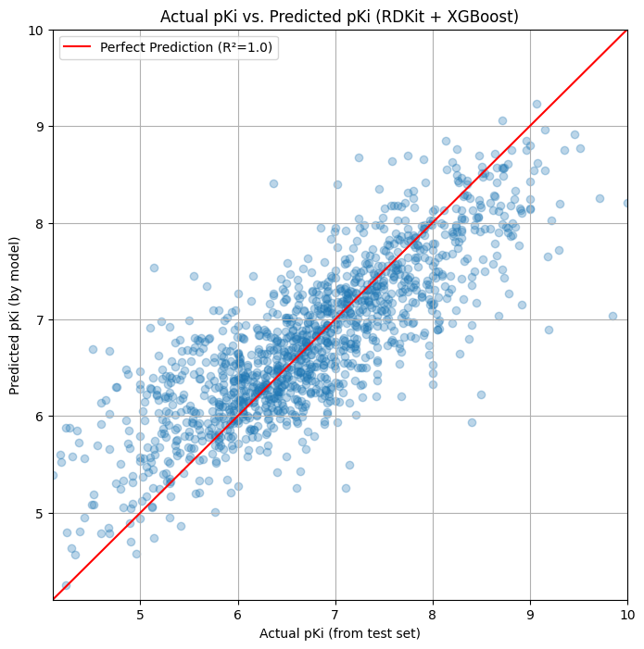
Experiment 1:
RDKit Descriptors + XGBoost

Slide 11
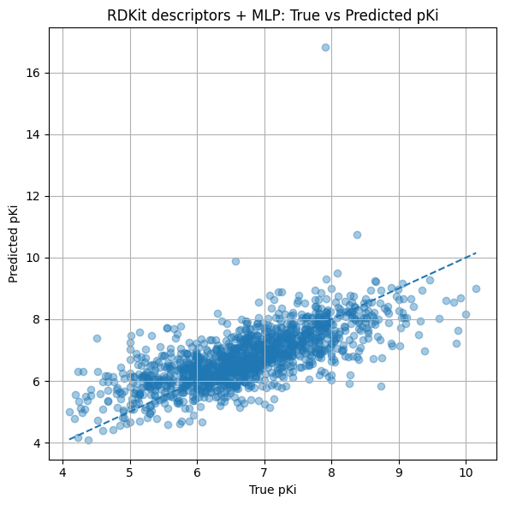
Experiment 2:
RDKit Descriptors + MLP

Slide 12
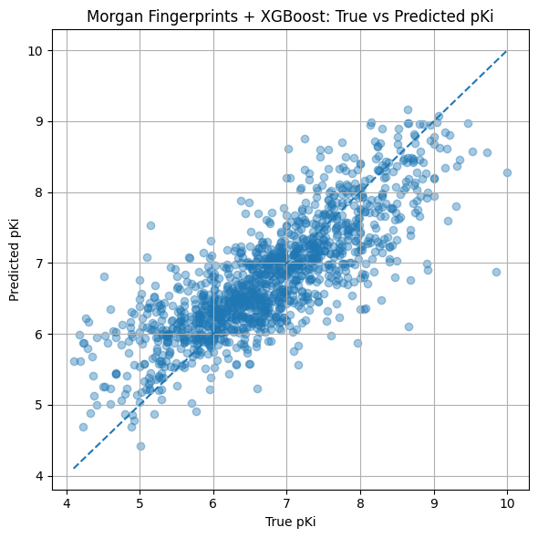
Experiment 3:
Morgan Fingerprints + XGBoost

Slide 13
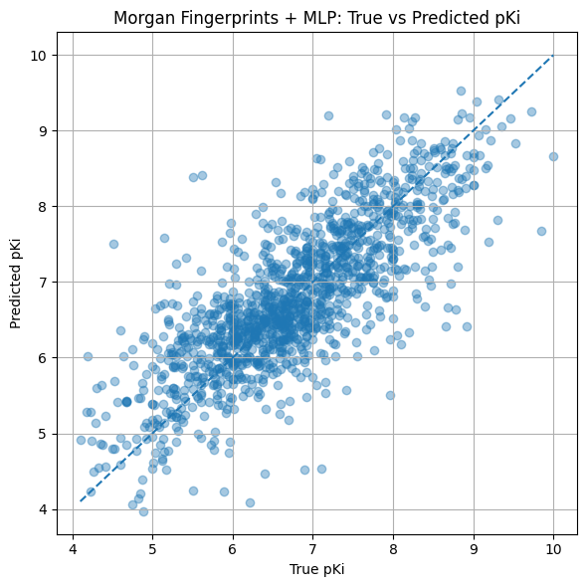
Experiment 4:
Morgan Fingerprints + MLP

Slide 14
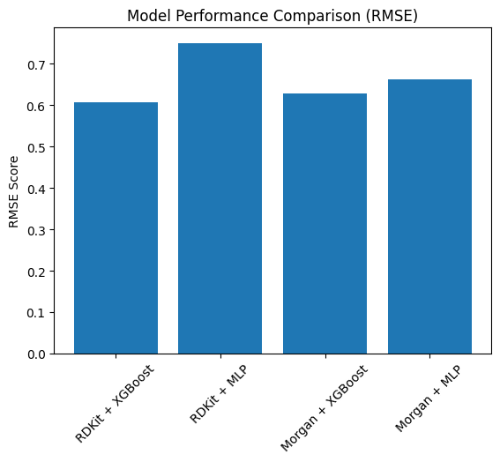
Workflow: Evaluation (Student 6)
Compare Metrics: Collect the R-squared (R²) and RMSE (Root Mean Square Error) from all four models.
Select Best Model: The model with the highest R² (closest to 1.0) and lowest RMSE (lowest error) will be chosen as our final baseline model.
Final Analysis: This winning model is what we will present to the CEO for use in screening the new vendor catalogue.

Slide 15
THANK YOU ! CADD GROUP PROJECT TEAM

